Slide 1



Hospitality Project PowerBI
View in Power BI
Last data refresh:
10/6/2024 2:58:29 PM UTC
Downloaded at:
10/6/2024 3:00:44 PM UTC

Slide 2
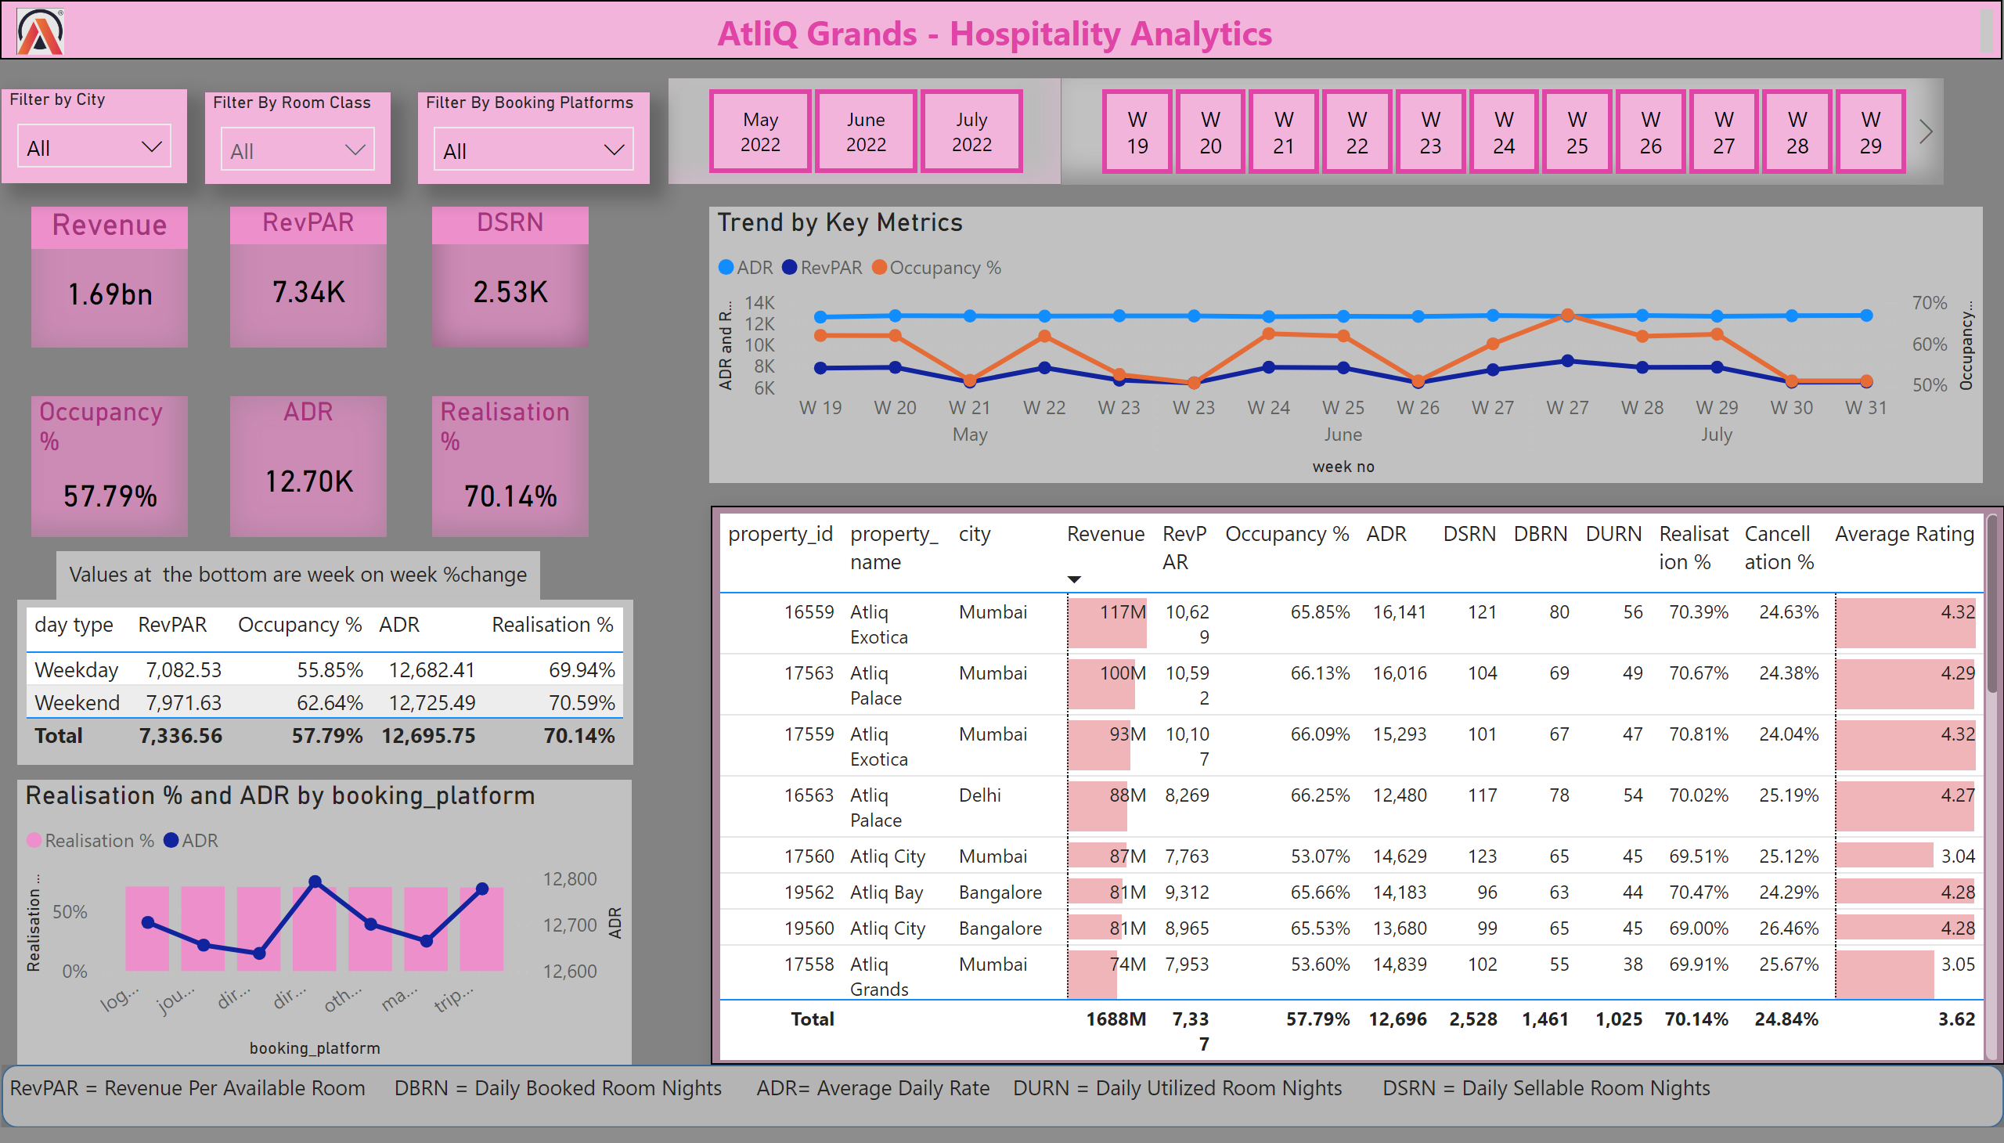
Home
Notes:
tableEx
No alt text provided
Revenue
No alt text provided
RevPAR
No alt text provided
tableEx
No alt text provided
DSRN
No alt text provided
ADR
No alt text provided
Occupancy%
No alt text provided
Realisation%
No alt text provided
tableEx
No alt text provided
lineClusteredColumnComboChart
No alt text provided
Trend by Key Metrics
No alt text provided
shape
No alt text provided
textbox
No alt text provided
textbox
No alt text provided
image
No alt text provided
textbox
No alt text provided
Filter By Booking Platforms
No alt text provided
Filter By Room Class
No alt text provided
Filter by City
No alt text provided
slicer
No alt text provided
slicer
No alt text provided
textbox
No alt text provided
textbox
No alt text provided
image
No alt text provided

Slide 3
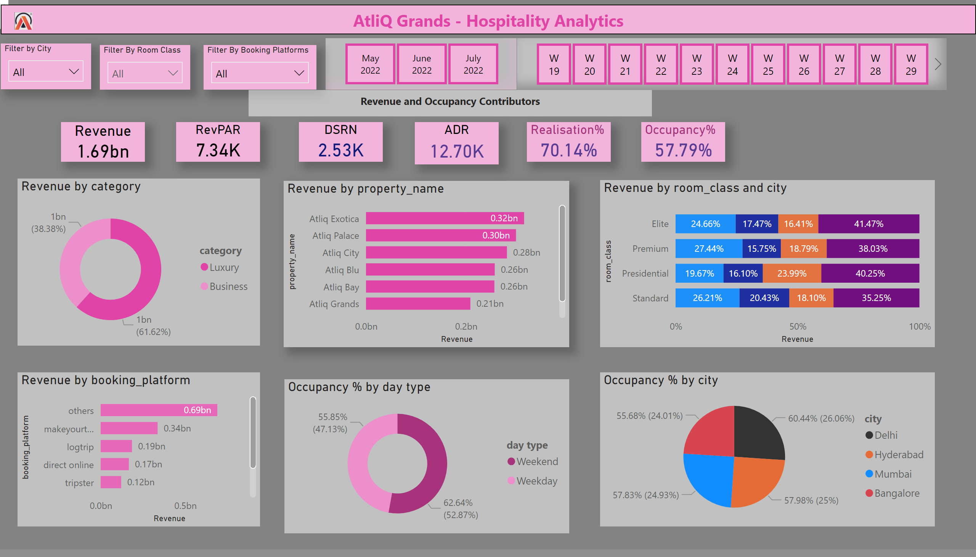
Revenue and Occupancy
Notes:
Revenue
No alt text provided
RevPAR
No alt text provided
DSRN
No alt text provided
ADR
No alt text provided
Occupancy%
No alt text provided
Realisation%
No alt text provided
textbox
No alt text provided
textbox
No alt text provided
image
No alt text provided
donutChart
No alt text provided
barChart
No alt text provided
hundredPercentStackedBarChart
No alt text provided
barChart
No alt text provided
pieChart
No alt text provided
donutChart
No alt text provided
textbox
No alt text provided
Filter by City
No alt text provided
Filter By Room Class
No alt text provided
Filter By Booking Platforms
No alt text provided
slicer
No alt text provided
slicer
No alt text provided
textbox
No alt text provided
image
No alt text provided

Slide 4
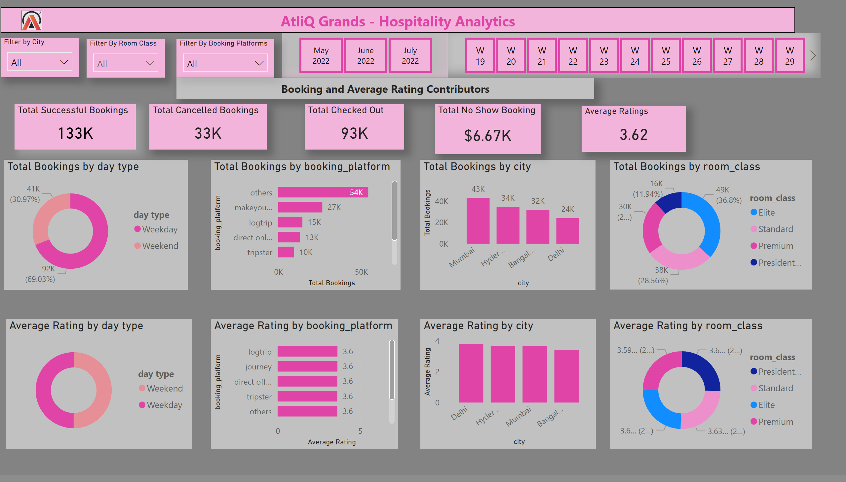
Booking and Average Ratings
Notes:
Filter by City
No alt text provided
slicer
No alt text provided
slicer
No alt text provided
Filter By Room Class
No alt text provided
Filter By Booking Platforms
No alt text provided
textbox
No alt text provided
image
No alt text provided
textbox
No alt text provided
textbox
No alt text provided
Total Successful Bookings
No alt text provided
Total Cancelled Bookings
No alt text provided
Total Checked Out
No alt text provided
Total No Show Booking
No alt text provided
Average Ratings
No alt text provided
donutChart
No alt text provided
clusteredBarChart
No alt text provided
clusteredColumnChart
No alt text provided
donutChart
No alt text provided
clusteredBarChart
No alt text provided
donutChart
No alt text provided
clusteredColumnChart
No alt text provided
donutChart
No alt text provided
image
No alt text provided

